Slide 1




01
FINAL PROJECT

Slide 2

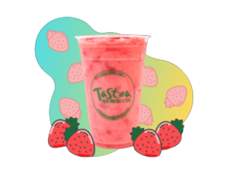

02
Tastea
Tastea

Slide 3

Tastea Overview
03
In 2021, the Philippines ranked second among the countries with the greatest number of bubble tea drinkers in Southeast Asia. A food delivery survey found out that Filipinos consume an average of five cups of milk tea in a month.

Slide 4

04
When the quarantine was put into effect in the community to slow down the spread of the virus. Many food establishments have reopened and have restarted operations, yet many of them only offer delivery, take-out, and pick-up services. Today, more than ever, delivery app aggregators (GrabFood, FoodPanda, etc.) and fast-food apps come in handy. Others choose to order food online for convenience, while some even do their grocery shopping online.
Reasons to use the Application

Slide 5
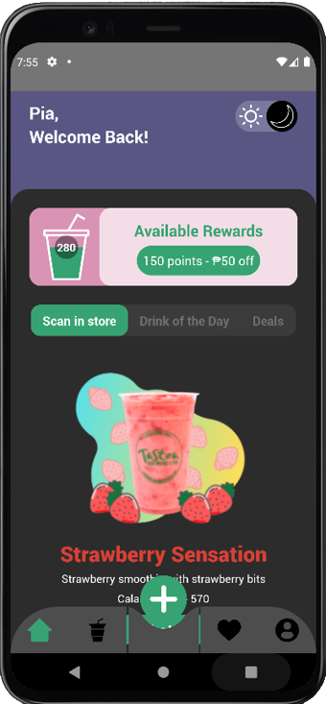

05
Application Features

Slide 6
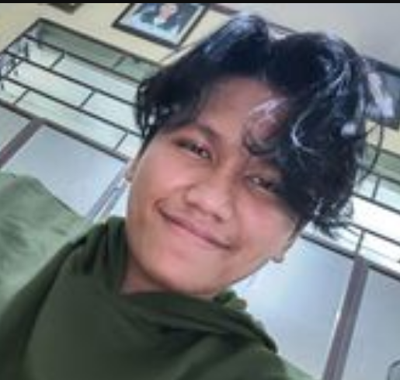
06
GEROME KENNETH BATAYOLA
LEAD MOBILE DEVELOPER & DESIGNER

